Slide 1
When the market is volatile, like during the financial crisis of 2007-2008, the Black-Scholes model, which has a constant volatility, is not good enough. Thus, We introduce Poisson Scale Mixture (PSM) distribution and develop a process based on this distribution. Option pricing model under the process is developed to incorporate the asymmetry of information and the corresponding implied volatility surface is numerically investigated. This model provides a good fit to observed option prices. To demonstrate the advantage of the new process, we conduct empirical studies to compare its performance to other processes that have been used in the literature.

Slide 2
THEORETICAL STUDY
ABSTRACT

Slide 3
THEORETICAL STUDY (cntd.)

Slide 4
Poisson Scale Mixture (PSM) Distribution
, where

Slide 5
Distribution Function and Probability Density Function
Distribution Function:
Probability Density Function:

Slide 6
Properties of PSM
Excess Kurtosis:

Slide 7
The Asset Pricing Model
subordinated type:

Slide 8
The Asset Pricing Model (2)
The discounted asset price:

Slide 9
Under Risk neutral World
The Radon-Nikodym derivative:
The discounted asset price process then becomes:
where the Brownian motion under the risk neutral world is

Slide 10
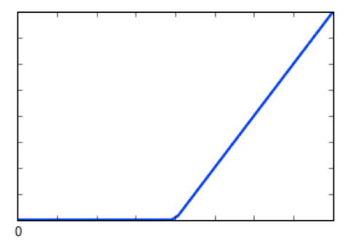
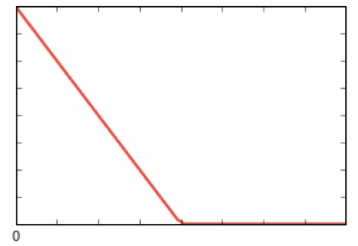
European option
European options are contracts that give the owner the right to buy or sell the underlying security at a specific price, known as the strike price, on the option's expiration date. A European call option gives the owner the right to purchase the underlying security, while a European put option gives the owner the right to sell the underlying security.
Call Payoff
Put Payoff
Strike price
Underlying asset
Strike price
Underlying asset

Slide 11
European Option Price Under PSM

Slide 12
European Option Price Under PSM (2)

Slide 13
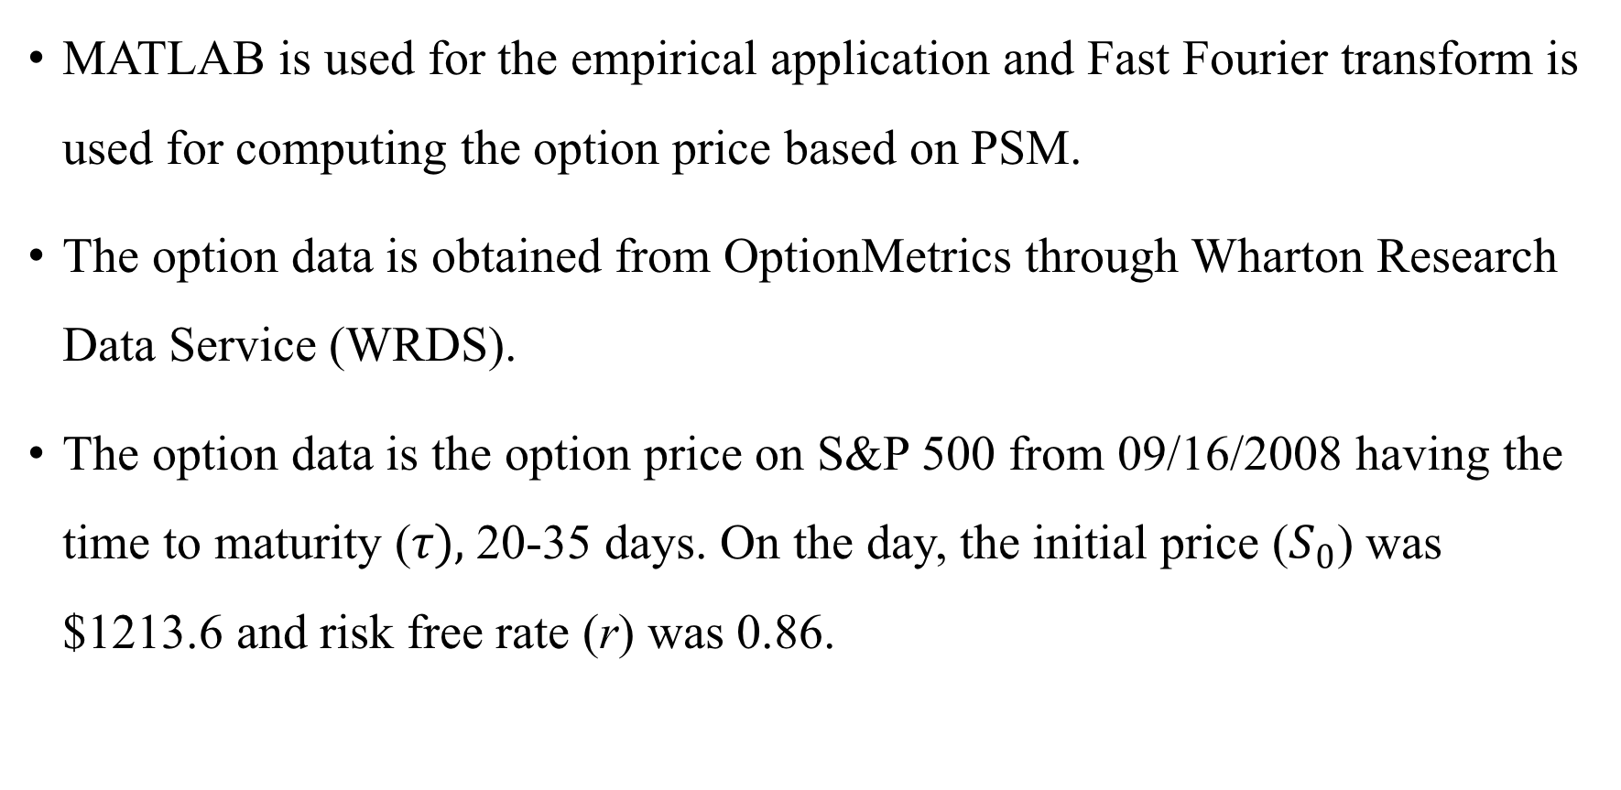
Data & Algorithm
MATLAB is used for the empirical application and Fast Fourier transform is used for computing the option price based on PSM.
The option data is obtained from OptionMetrics through Wharton Research Data Service (WRDS).
The option data is the option price on S&P 500 from 09/16/2008 having the time to maturity ($τ),$ 20-35 days. On the day, the initial price ($S_{0}$) was $1213.6 and risk free rate (r) was 0.86.

Slide 14
RESULTS

Slide 15
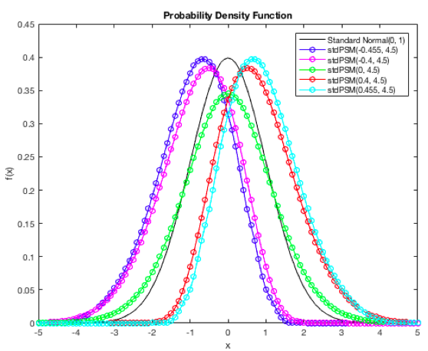
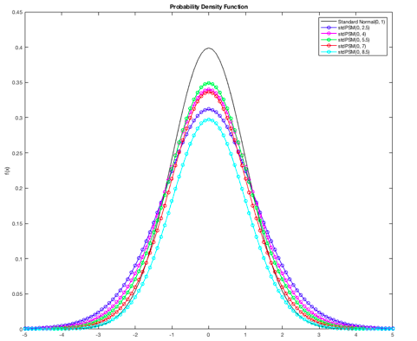
PDF of Standard Normal & Standard PSM

Slide 16
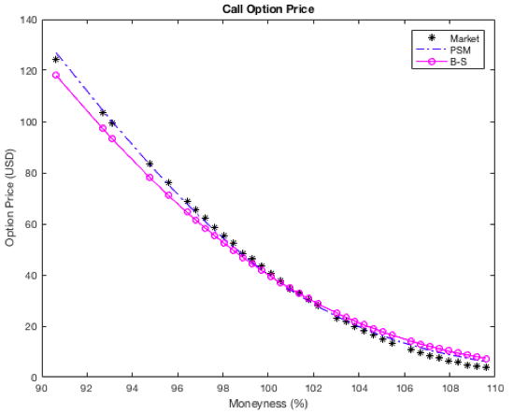
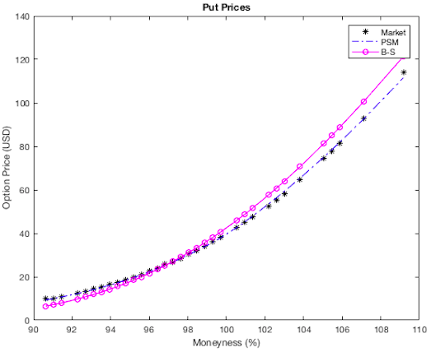
European Option Price
Notes:
Png/ pdf

Slide 17
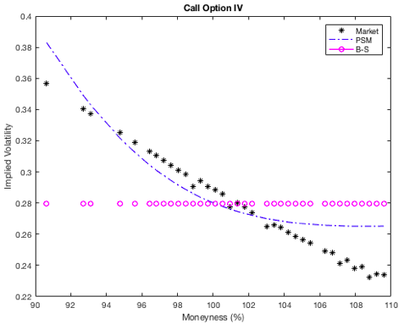
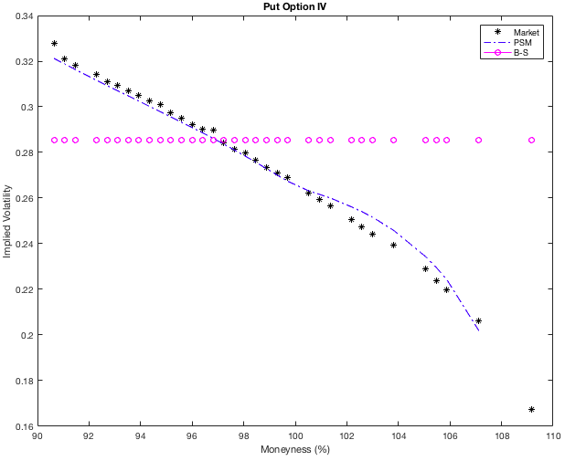
Implied Volatility

Slide 18
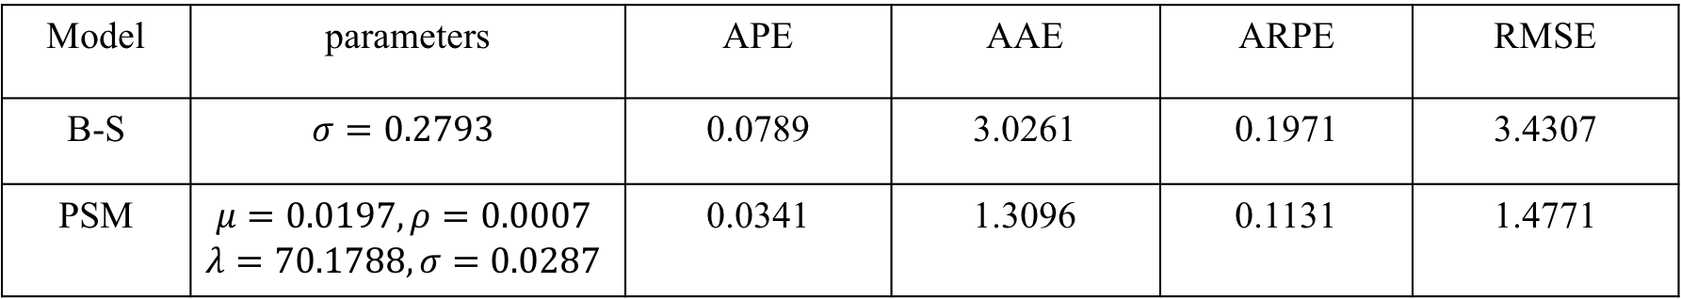
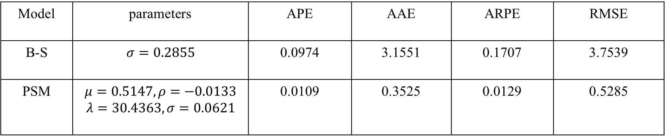
Goodness of Fit
European Call Option
Model | parameters | APE | AAE | ARPE | RMSE
B-S | $$σ=0.2793$$ | 0.0789 | 3.0261 | 0.1971 | 3.4307
PSM | $$μ=0.0197, ρ=0.0007$$ $$λ=70.1788, σ=0.0287$$ | 0.0341 | 1.3096 | 0.1131 | 1.4771
European Put Option
Model | parameters | APE | AAE | ARPE | RMSE
B-S | $$σ=0.2855$$ | 0.0974 | 3.1551 | 0.1707 | 3.7539
PSM | $$μ=0.5147, ρ=−0.0133$$ $$λ=30.4363, σ=0.0621$$ | 0.0109 | 0.3525 | 0.0129 | 0.5285
Notes:
S&P price/// S0, r, tau

Slide 19
Appendix

Slide 20
Goodness-of-Fit Measures
We have used four different measures for estimating the goodness of fit. They are the average absolute error as a percentage of the mean price (APE), the average absolute error (AAE), the average relative percentage error (ARPE), and the root-mean-square error (RMSE).

Slide 21
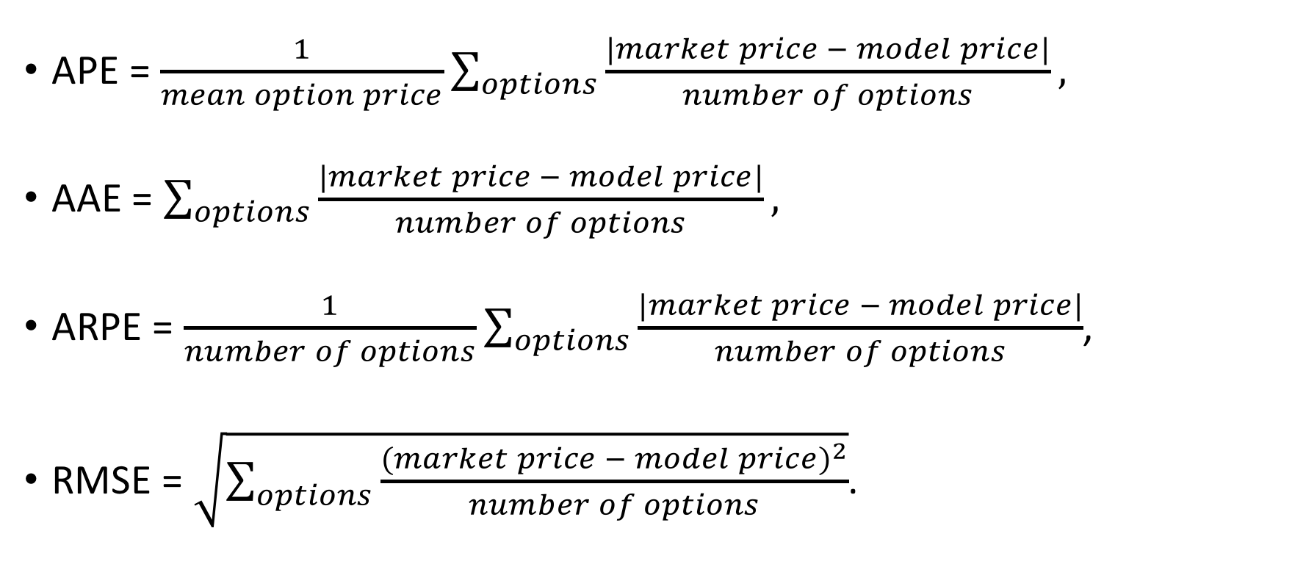
Goodness-of-Fit Measures (2)
APE = $\frac{1}{mean option price}\sum_{options}{\frac{|market price − model price|}{number of options}},$
AAE = $\sum_{options}{\frac{|market price − model price|}{number of options}},$
ARPE = $\frac{1}{number of options}\sum_{options}{\frac{|market price − model price|}{number of options}}$,
RMSE = $\sqrt{\sum_{options}{\frac{{(market price − model price)}^{2}}{number of options}}}$.

Slide 22
CONCLUSIONS
PSM random variable has much more flexible distribution than normal distribution for explaining the return distribution such as skewness and non-Gaussian tail dependencies.
PSM distribution can explain asymmetric information among traders.
Compared to the Black-Scholes model, the option pricing based on PSM distribution has an improved fit for European options. Also, the implied volatility looks much more reasonable than the constant volatility of Black-Scholes model.

Slide 23
Poisson

Slide 24
Scale

Slide 25
Mixture

Slide 26
Model

Slide 27
ACKNOWLEDGEMENTS
I would like to express my sincere gratitude to my mentors, Dr. Aaron Kim and Dr. Zari Rachev for the guidance and giving me the opportunity to make this project. This research was supported with funding from Undergraduate Research & Creative Activities (URECA).

